Slide 1
Welcome to
Math & Logic!
With Ruth Carlson

Slide 2
Review: What did we do in class last time?
Preview: What are N, W, Z, Q, I, R?
Notes:
Review: Numbrix Puzzle -- documenting our problem-solving strategies
Preview: Shorthand for sets of numbers

Slide 3
Sets and Algebra
Competency: Solve Applied Algebraic Problems
Competency: Apply Principles of Set Theory
Sets of Real Numbers
Properties of Real Numbers
Exponents
Order of Operations

Slide 4

Sets of Real Numbers
Notes:
Let’s write down some real numbers and organize them. View: Sets of Real Numbers and Somalia

Slide 5
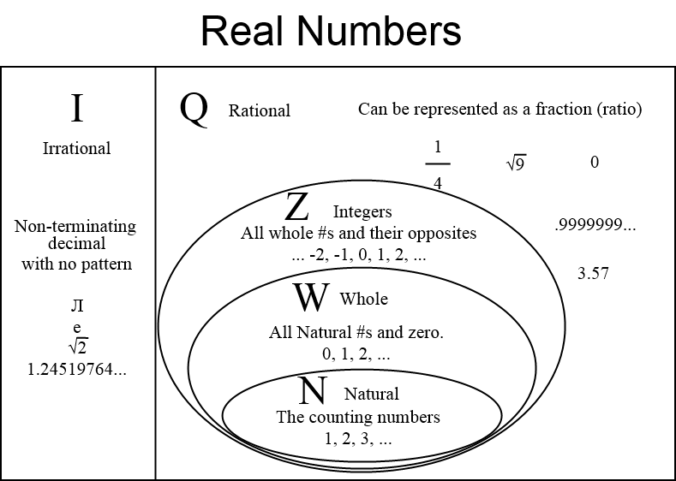
Sets of Real Numbers
Notes:
We will work with real numbers in this class.

Slide 6
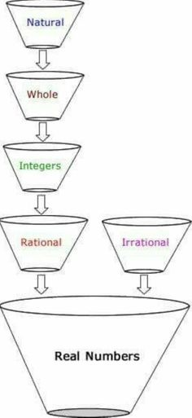
Sets of Real Numbers
Natural numbers are in this set: {1, 2, 3, 4, 5, 6, ...}
Whole numbers are in this set: {0, 1, 2, 3, 4, 5, 6, ...}
Integers are in this set: {..., -5, -4, -3, -2, -1, 0, 1, 2, 3, 4, 5, ...}
Rational numbers can be written as a ratio (a fraction) of two integers such as 2/1, 3/4, -66/10, -17/33. Rational numbers written in decimal form either terminate or repeat.
Irrational numbers cannot be written as a ratio (a fraction) of two integers. Irrational numbers written in decimal form do not terminate and do not repeat.Two examples are pi ≈ 3.141592653… and the square root of 3 ≈ 1.7320508075...
A number is either rational or irrational -- it cannot be both
The rational numbers together with the irrational numbers are the Real numbers.
Notes:
We will work with real numbers in this class.

Slide 7
Sets of Real Numbers
Let’s practice now!
Determine to which sets the numbers belong. 1) 7 2) ‒13 3) √2
4) ‒5 5) 23/37 6) π
Notes:
N, W, Z, Q, I, R See Practice in Canvas

Slide 8


Properties of Real Numbers
Commutative Property
Associative Property
Identity Property
Inverse Property
Distributive Property

Slide 9
Properties of Real Numbers
Name each property.
10 + 0 = 10
4 * 3 = 3 * 4
5/1 * 1/5 = 1
Notes:
See Practice in Canvas

Slide 10
Properties of Real Numbers
Fill in the blank and name the property.
a + c = ____ + a
2 * _____ = 1
23 * _____ = 23
Notes:
See Practice in Canvas

Slide 11
Properties of Real Numbers
Give an example supporting each answer.
Is division associative?
Is subtraction commutative?
Notes:
Is division associative? Is (60/12)/2 equal to 60/(12/2)? Is subtraction commutative? Is 11-2 equal to 2-11?

Slide 12
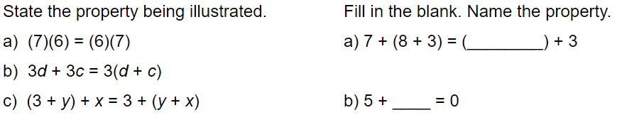
Properties of Real Numbers
Let’s practice now!
Notes:
See Practice in Canvas

Slide 13
Exponents
If b is a real number and n is a natural number, then b^{n} = b∙b∙b∙ … ∙b, where b occurs n times.
Base b
Exponent or Power n

Slide 14
Exponents
Natural exponent
8² =
2³ =
16¹ =

Slide 15
Exponents
Zero exponent
10⁰ =
2⁰ =
Hint: Try these with your scientific calculator.
Notes:
Look for a pattern: 10^3 = 1000, 10^2 = 100, 10^1 = 10, 10^0 = 1, reducing the exponent by 1 is like dividing by 10 2^3 = 8, 2^2 = 4, 2^1= 2, 2^0 = 1, reducing the exponent by 1 is like dividing the exponent by 1

Slide 16
Exponents
Negative exponent
2⁻¹ =
10⁻² =
2⁻³ =
10⁻⁴ =
Notes:
Continue the patterns 10^3 = 1000, 10^2 = 100, 10^1 = 10, 10^0 = 1, 10^(-1) = 1/10, 10^(-2) = 1/100, 10^(-3) = 1/1000 2^3 = 8, 2^2 = 4, 2^1= 2, 2^0 = 1, 12^(-1) = 1/2, 2^(-2) = 1/4, 2^(-3) = 1/8

Slide 17
Exponents
Rational exponents and radical expressions
16^{5/4} =
64^{1/4} =
10 000^{3/4} =
100^{5/2} =
Notes:
The denominator is the root (or index), the numerator is the power (or exponent) 16^(5/4) is the fourth root of 16 raised to the fifth power, 16^(5/4) = 32
See exercises 11-20 on this Practice

Slide 18
Exponents
Let’s practice now!
Evaluate: 2⁴
Evaluate and write as a fraction: 2⁻³
Evaluate and write as a decimal: 10⁻¹
Evaluate: 256^{1/4}
Write as a radical and evaluate: 100^{3/2}
Notes:
See Practice in Canvas

Slide 19
Order of Operations
Evaluate the expression.
4 ‒ 2³ * 4 4 ‒ 3[4 ‒ (4 + 1) * 3]
Notes:
Use your scientific calculator Positive minus negative ( https://www.khanacademy.org/math/cc-seventh-grade-math/cc-7th-negative-numbers-add-and-subtract/cc-7th-sub-neg-intro/a/subtracting-negative-numbers-review )

Slide 20
Order of Operations
Grouping symbols
Exponents
Multiply and Divide from left to right
Add and Subtract from left to right
Notes:
See Practice in Canvas Another way is PEMDAS, Parentheses, Exponents, Multiply and Divide from left to right, Add and Subtract from left to right

Slide 21
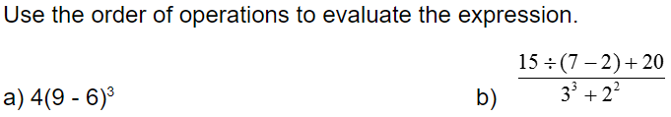
Order of Operations
Let’s practice now!
For each expression, which operation will be performed last?
Notes:
See Practice in Canvas

Slide 22
Review
Sets of Real Numbers
Properties of Real Numbers
Exponents
Order of Operations

Slide 23
To Do:
Sets of Real Numbers
Properties of Real Numbers
Exponents
Order of Operations
Crash Course 01
Crash Course 02
Do all of these before Feb 5th morning at 11am.

Slide 24
Have a great day!
And remember that every day
at CVTC is a great day!

